Slide 1

ONLINE SALES DATA ANALYSIS
Presented By:
Shruti Mishra
Guided By:
Mr. Randhir Gawai

Slide 2
Project Overview
The primary objective of this project is to analyze the provided online sales data to derive actionable insights regarding sales trends, product performance, regional sales distribution, and payment method preferences. These insights will help in understanding customer behavior, optimizing inventory management, and informing strategic marketing decisions.

Slide 3
Dataset Description
The dataset comprises online sales transactions with the following columns:
Transaction_ID: Unique identifier for each transaction.
Date: Date of the transaction.
Product_Category: Category of the product sold.
Product_Name: Name of the product sold.
Units_Sold: Number of units sold in the transaction.
Unit_Price: Price per unit of the product.
Total_Revenue: Total revenue generated from the transaction.
Region: Geographical region of the transaction.
Payment_Method: Method of payment used.

Slide 4
Objective
The main goal of this project is to analyze the provided online sales data to gain insights into sales trends, product performance, regional distribution of sales, and payment methods used. This analysis will help in understanding customer behavior, optimizing inventory, and strategizing marketing efforts.

Slide 5

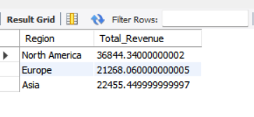
Analysis
1.What is the sum of total revenue generated from each region?

Slide 6


Analysis
2. What is the total units sales?

Slide 7

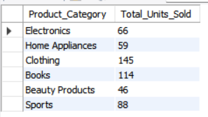
Analysis
3. What is the total units sold according to each product category?

Slide 8
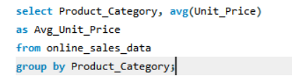
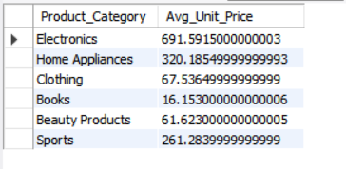
Analysis
4. What is the average unit price according to product category?

Slide 9

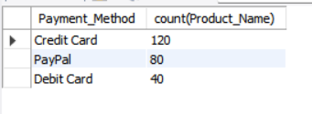
Analysis
5. Most used Payment method

Slide 10

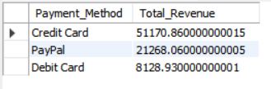
Analysis
6. Maximum revenue received from which payment mode?

Slide 11
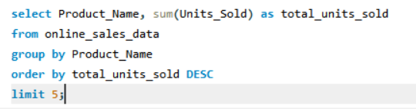
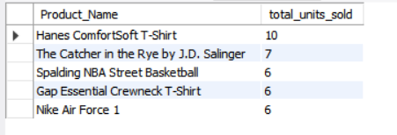
Analysis
7. Top 5 units sold by product name

Slide 12
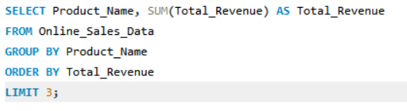
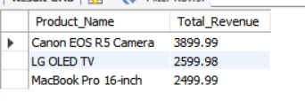
Analysis
8. Top 3 most revenue generating products

Slide 13
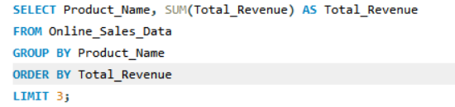
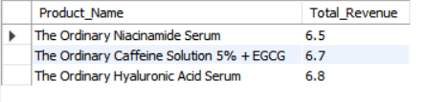
Analysis
9. Top 3 least revenue generating products

Slide 14
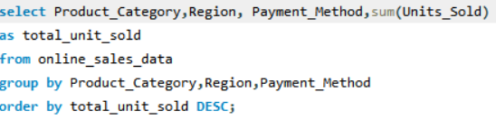
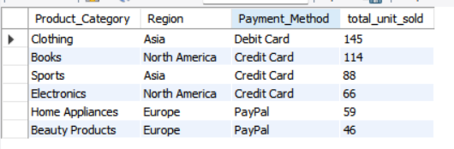
Analysis
10. Total units sold specifying the product category, region by payment method.

Slide 15
Key Insights
Most profitable product name
Canon EOS R5 Camera
Most revenue generating product category
Clothing
Which payment mode is most famous
Credit Card
Which region is generating the most revenue
North America
Which products are generating the least revenue
The Ordinary Niacinamide Serum
Max average unit price according to the product category
Electronics

Slide 16
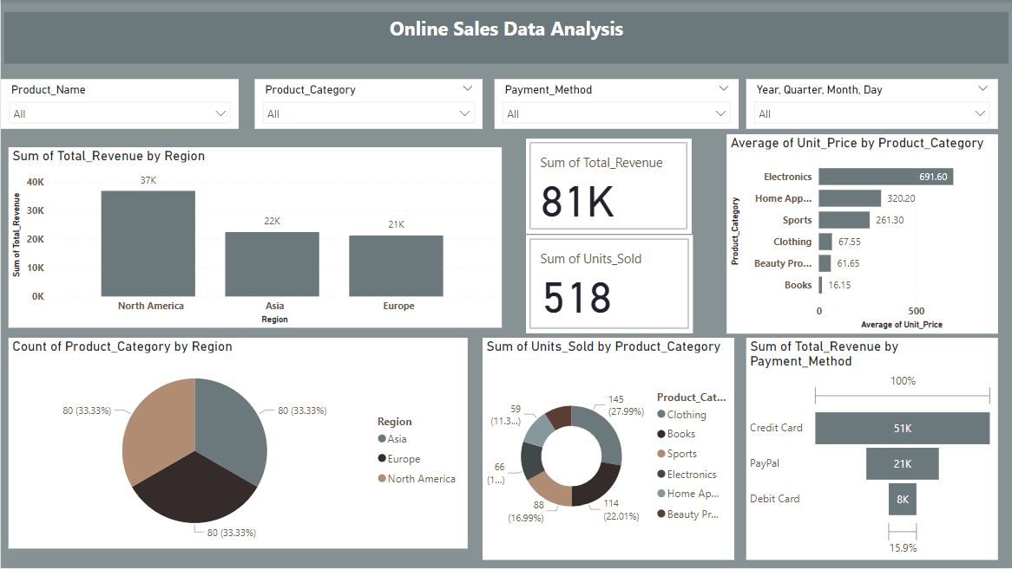
Visual Insights

Slide 17
THANK YOU

